Slide 1

Risky Business
Leveraging common risk concepts across operational, security, business and financial risks.
V1.1
Risk RFI Response
Cory Casanave, Model Driven Solutions
Cory-c@modeldriven.com

Slide 2
Foundations
Operational threat/risk model
Focused on operational risk but utilizes an approach that defines operational risk in terms of general concepts
Multiple sources of input
Intentional Physical Risks – e.g. terrorism & crime
Unintentional Risks – Safety & Natural Occurrences
Financial Risks – e.g. FIBO
Common concepts and terms
Methodology
Define domain specific concepts in terms of more general concepts that are domain and application independent. Most information sharing and federation crosses domains.
Represented in Concept Modeeling profile of UML using Magicdraw
However, we have not had sufficient review of generic risk concepts – so operational bias may be seen.
Note that what is presented is a subset of the models.

Slide 3
Focus
Multiple communities
Information federation, sharing and integration about threats, risks and the threatened entities, systems and environments
Focus on design of secure systems or systems assurance (UAF).
Financial risk
Enterprise risk management
However, all of these goals share concepts
We are focusing on conceptual reference models – not a data model, application model, tooling model or model of what we may know. These reference concepts are then used as a pivot point between communities, organizations, systems and data models.
Therefore, it is not expected that elements of these models are known or required for any particular application – only that if they are known or required, what the data is representing is semantically well grounded. Models are typically referenced, not imported.

Slide 4


Shift in Information Sharing, Integration and Federation Approach
Schema Based
Concept Based
Ask every stakeholder and system to adapt to externally imposed fixed schema, change in schema or systems requires development
Ask every stakeholder to map their schema to shared concepts, data mappings are automated, n-way & agile

Slide 5
Source of Concepts
Highlight O(N) vs. O(N^2)
Cyber
Terrorism
Cyber
Cyber
Construct a conceptual reference model informed by existing schema, ontologies, research and best practices
This conceptual reference model is independent of specific data structures, technologies and terminologies
Define mapping models between the conceptual model and purpose/technology schema
Non operational sources are included.
Make both models sufficiently precise that they can drive automated data bridging between any mapped schema
Cyber
Finance
Map/Bridge
Map/Bridge
Map/Bridge
Conceptual Model
Cyber
Map/Bridge
Safety
Map/Bridge
Map/Bridge
Map/Bridge
Criminal
Cyber
Criminal
Infrastructure
Criminal
Enterprise
Risk

Slide 6

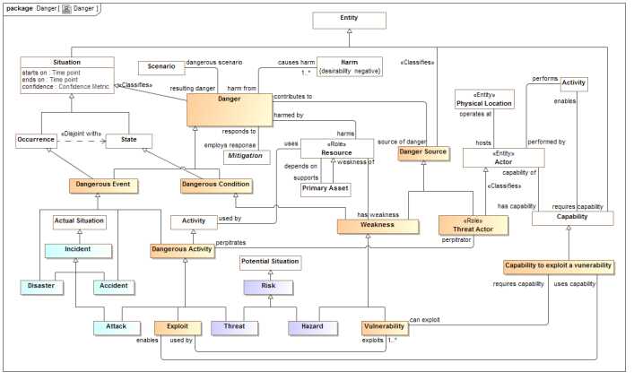
Conceptual Model Inputs
KDM
(Risk)
NIST Framework
Conceptual Model
NIEM
(General)
STIX
(Cyber)
OGC
(Geo)
EDXL
(Emergency)
FIBO (Finance)
SEI
(Safety)
CAL OES
(Health)
ISO
(Risk)
ISO
(Units)
RMS
(Custody)
There is still more to do to fully integrate the above and we anticipate more inputs and use cases

Slide 7
Models to Capabilities
Mappings
Conceptual Model
Vocabularies
Ontologies
Data Schema
STIX, NIEM, EDXL, Others
Data Transformations
Products and services implementing the standards provide the capacities for information sharing, federation and analytics based on mappings to data-focused technologies

Slide 8

Lets Get Risky
Concepts of Risk

Slide 9
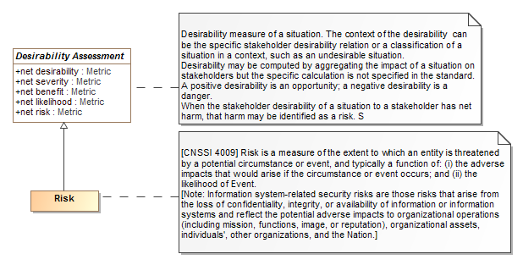
Definitions
Important take-away: Risk is not the “bad thing” but an assessment of the likelihood and impact of bad things as it relates to a stakeholder – the “risk owner”.

Slide 10
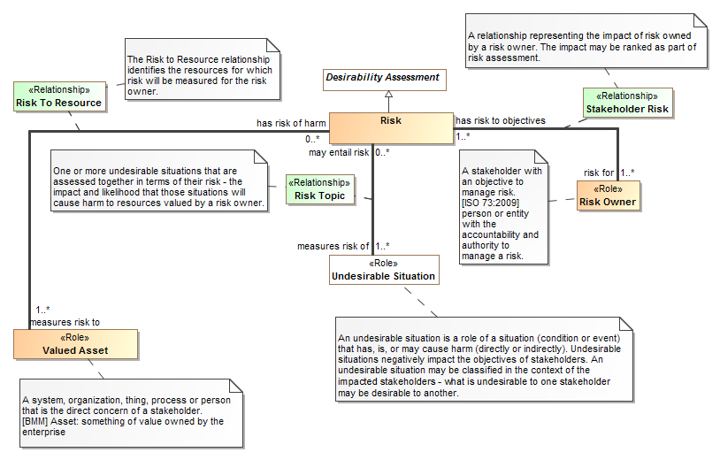
Fundamental Relationships

Slide 11
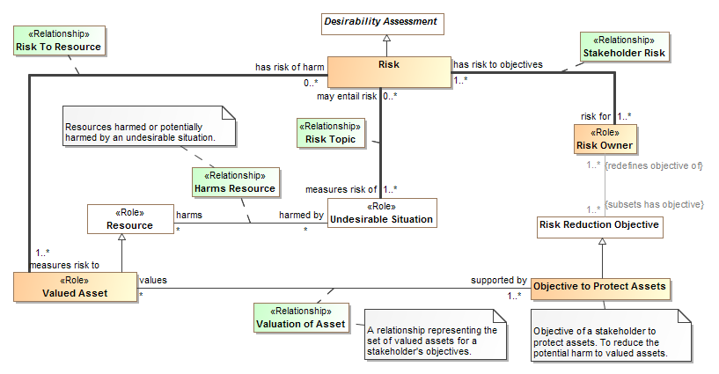
Supporting Relationships

Slide 12
Take Away
A risk is assessed with respect to
The risk is a risk for – the risk owner {who}
The risk measures the risk to – the valued asset(s) {impacts}
The risk measures the risk of – the undesirable situation(s) {cause}
This is assessed based on supporting relations, including:
That potential undesirable situation(s) {threats} harms resources that are valued assets
That risk owners (as stakeholders) have objectives
That some of these are objectives to protect assets
These objectives values a valued asset – thus rounding the circle.
Also causality, parthood and other dependencies – not shown
Note: Every relationship can have confidence, context, temporality and provenance.
Reminder: These define the concepts, not what may be needed in some schema or known in a specific situation.

Slide 13
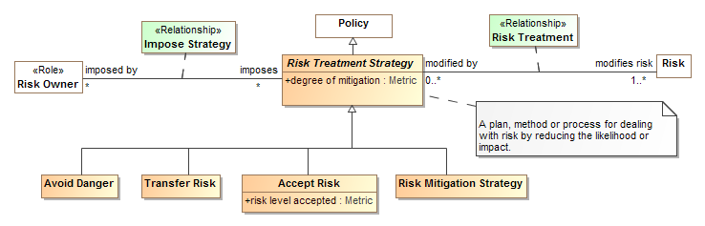
Risk Treatment Strategies
Take Away: A risk treatment strategy (a strategy) modifies risk of one or more risks.
It is imposed by a risk owner.
There are 4 widely accepted strategies: Avoid danger, transfer risk, accept risk or impose a risk mitigation strategy.

Slide 14
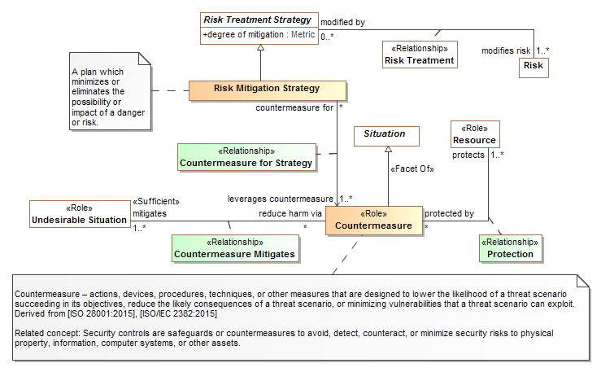
Risk Mitigation and Countermeasures
Take away: risk mitigation requires countermeasures that reduce impact and/or likelihood

Slide 15
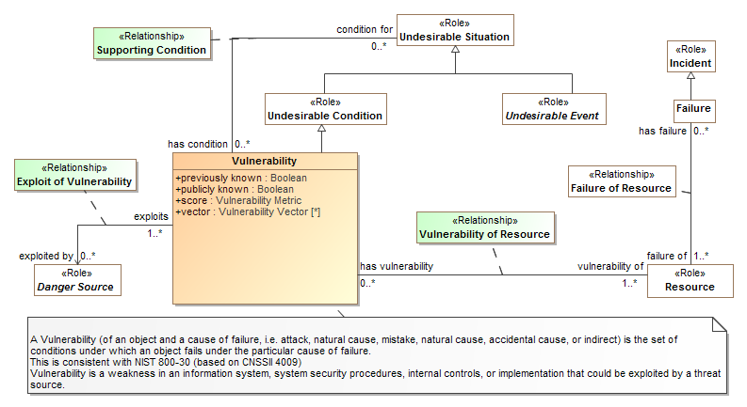
Vulnerabilities
Take Away: Vulnerabilities relate a sources of danger to vulnerable resources that may be a condition for an undesirable situation

Slide 16
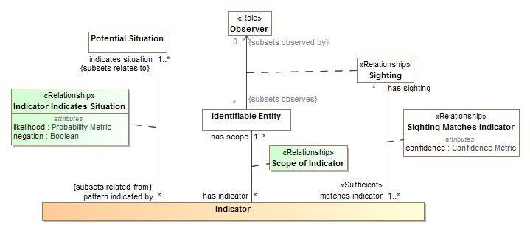
Indicators – of any situation
Take Away: Indicators indicate a potential situation based on specific conditions and sightings that match those conditions.
Indicators may be used for risks, benefits or any other potential situation.

Slide 17
Is “Risk” Domain Specific?
Nothing is what has been discussed so far is domain or “Operational” specific, it could apply to…
Risk of a terrorist breaching an airport and causing loss of life with respect to the airport as the risk owner.
Risk of a mortgage not being paid and loosing value with respect to a mortgage holder
Risk of reputation loss due to a faulty product with respect to a manufacturer
Risk of a reactor shutdown due to a faulty pump with respect to a power company
Risk of a child being hurt by falling down an open hole with respect to the child’s parents
Risk of information loss due to a system security vulnerability exploitation with respect to an information owner
Conclusion to be tested: These risk concepts are general and cross-domain

Slide 18
What are “Kinds of Risk”?
What are informally referred to as “kinds of risk”. E.g.
Financial risk
Terrorism risk
Reputation risk
Cyber risk
Business risk
Are actually different kinds of…
Undesirable situations
Valued assets
Danger sources, including threat actors
This impacts the methodology for assisting likelihood and impact, not the concepts of risk, mitigation strategies, vulnerabilities or indicators.

Slide 19
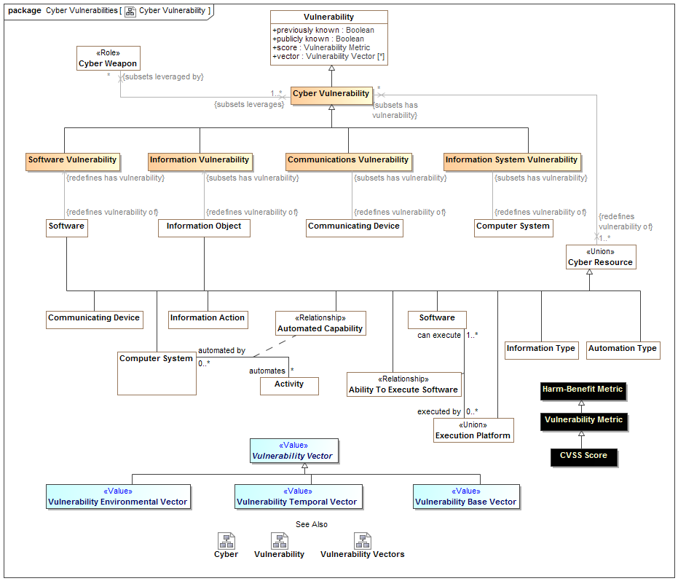
Example specialization of Vulnerabilities

Slide 20
Categories also provide domain insight
Categories can specialize:
Impact (this is the most typical for business risk )
Source of a danger
What may fail
The following are categories identified in operational threat/risk
Business risk would add additional categories, examples:
Market risk, credit risk, Legal risk, etc.

Slide 21
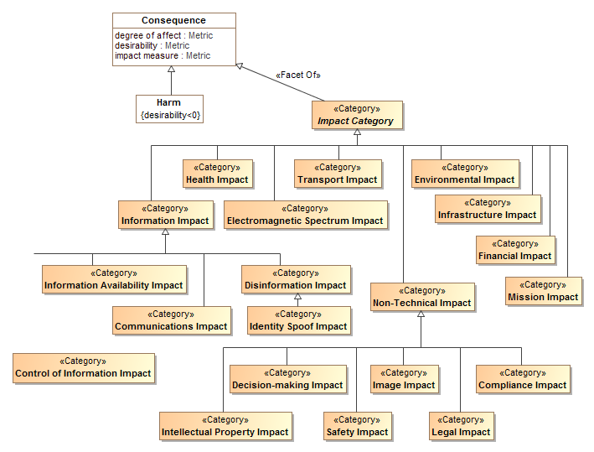
Impact Categories

Slide 22
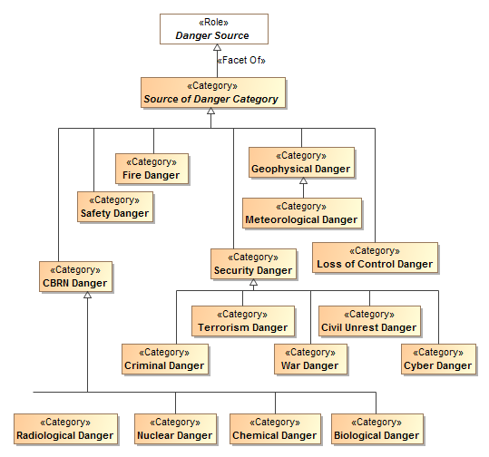
Source of danger categories

Slide 23
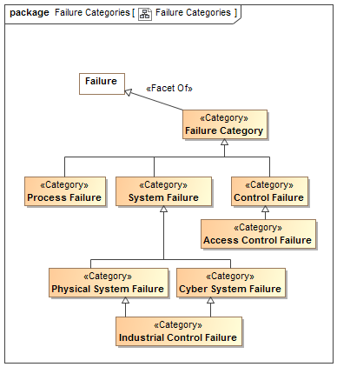
Failure Categories

Slide 24
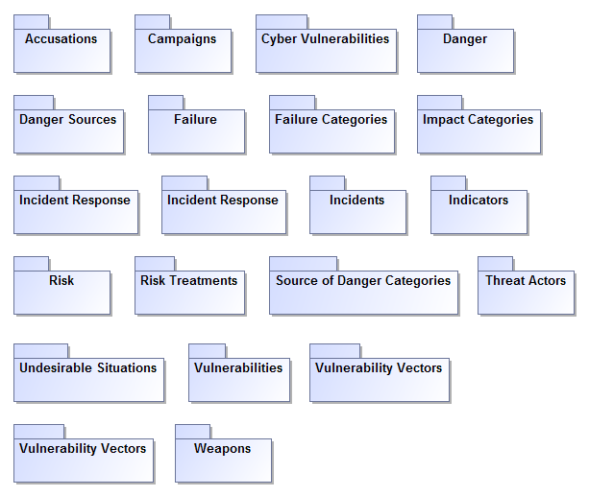
Threat/Risk Packages

Slide 25
Generic Concept Library Packages
Assessments
Contact Information
Abilities
Composite Conditions
Containment
Control
Credentials
Cyber
Enterprises
Corporations
Entities
Occurrences
Geopolitical Organizations
Entities
Observations
Locations
Objectives
Information
Identifiers and Coordinates
Permissions
Organizations
Places
Persons
Physical Entities
Processes
Process Effects
Policies
Predictions
Quantities and Units
Resources
Response
Quantity Kinds
Scenarios
Situations
Social Agents
Systems
Units
Vendors and Producers
Time & Temporal Entities
Topics related to sharing and federating information relative to threats and risks but not specific to threats or risks

Slide 26
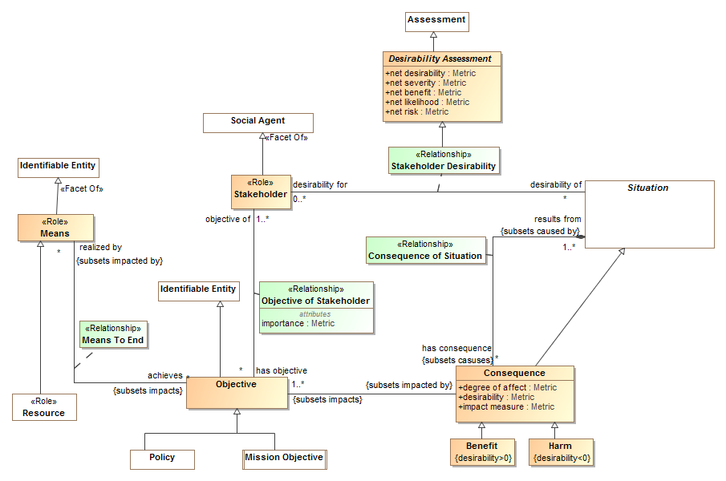
Example package - Objectives

Slide 27
Proposed Approach
Lets provide a foundation for federation of risk concepts, not more stovepipes
Work together to define generic cross-domain concept libraries
Specialize these for domain and application specific needs
Thus providing for cross-domain information sharing, integration and federation.
“Domains” are a myth with respect to broad base sharing and federation!
Threat/risk and its generic concept library provides a starting point, there are other starting points as well, such as FIBO.
To help with this we are starting to publish conceptual models as open source concept libraries.
These can then be pulled into OMG vertical specifications as they are needed, but defined and published as cross-domain assets.

Slide 28
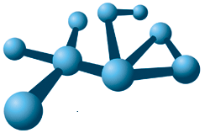
ConceptLibraries.org
Federating data and systems with concept models requires, well, concept models.
To be mapped, data elements need to be mapped through the same concept or concept pattern
There is no expectation of any single “true” concept model
We need to collect and curate a library of reference concepts
ConceptLibraries.org (a github site) is intended for this purpose
ConceptLibraries.org is being announced, we invite your participations
The models are open source and intended for community use, refinement and extension
It is “seeded” with three libraries
The domain independent federated concept library
The FIBO financial business ontology
The draft OMG threat/risk model
Under Construction

Slide 29
Discussion

